Slide 2


E-COMMERCE ANALYTICS
Organization: ExcelR
[Date: 27’th June 24]
Presented By:
Sonali Shinde
Soma Sandhya
Pranay Wani

Slide 3
OUR TEAM
Sonali
Shinde
Renuka
Talari
Soma
Sandhya
Manideepika
Talari
Namita
Ratnaparkhi
Pranay
Wani

Slide 4





Slide 5
KPI - 1
Problem Statement: Weekday Vs Weekend Payment Statistics
Insights:
Weekday Dominance - Higher sales on weekdays indicates customers are more active on weekdays for shopping. Reasons could be less leisure time, routine shopping habits, etc.
Weekend Trends - Although lower sales on weekends, could indicate different shopping behaviour. May be people prefer leisure activities, hobbies, travelling, etc.
Marketing Strategies: Seller might offer promotions, discounts, special offers on weekdays to maximize sales attracting more customers.

Slide 6
Suggestions:
Targeted promotions: Implementing weekday-specific promotions, special offers could be given on weekends also to boost sales.
Spends on Ads: Adjust online advertising budget on weekdays by not neglecting weekends too.
Customers feedback: Collect & analyze customers feedback to understand their shopping patterns. This will provide deeper insights about their preferences and habits.

Slide 7
KPI - 2
Problem Statement: No. of orders with review score ‘5’ and payment type as ‘credit card’
Insights:
Higher spending power and flexibility.
Earning reward points which can be redeemed against more purchases.
Fraud protection: Credit cards often offer better fraud protection & dispute resolution than other payment modes. Security is most concerned aspect for any customer.
Delayed payment: With credit cards, customer could choose to pay in EMI’s (Easy Monthly Installments).

Slide 8
Suggestions:
Alternative payment methods: Make other payment methods available and easy to use.
Incentives for alternative payments: Offer occasional incentives on using other payment methods to balance & reduce single payment type dependency.
Payment assistance: Provide strong customer support for failed payments & refund processes.
Analyze trends: Regularly analyze payment data to know any shifting in payment preferences. This can help in adjusting strategies.

Slide 9
KPI - 3
Problem Statement: Avg. no. of days taken for order delivered customer date for pet shop
Insights:
Dissatisfaction: 11-day delivery time might be longer than expected for some customers, who might need promptly like pet food or supplies.
Impact on business: Longer delivery times on repetitive basis could negatively impact on customer satisfaction & reduce the likelihood.
Competition: If competitors offer faster deliveries, this may impact your store. Customer might choose competitors over your store.

Slide 10
Suggestions:
Improving delivery speed: Review & optimize your supply chain processes which may be useful in faster deliveries.
Offering faster ship time: Provide customers an option of faster delivery for an additional fee. This gives customers control over their orders resulting in more satisfaction.

Slide 11
KPI - 4
Problem Statement: Avg. price and payment value from customers of ‘Sao Paulo’ city
Insights:
The average payment value is more as compared to average price of the product.
Average price value – 111 units, which is slightly lower than the payment value, indicating additional cost (such as shipping cost or any other taxes) is a part of the total payment.

Slide 12
Suggestions:
The higher payment as compared to price suggest that people of ‘Sao Paulo’ city are willing to spend more than the average price for goods or services.
To increase sales in other cities, we can work on faster deliveries, easy and efficient payment methods and product wise offers.
Emphasize quality, unique features or superior customer service to justify the higher prices and enhance customer satisfaction.

Slide 13
KPI - 5
Problem Statement: Relationship between shipping days vs review scores
Insights:
Less shipping days is having higher review score.
Higher shipping days is having low review score.
Customer satisfaction is based on shipping days.

Slide 14
Suggestions:
The observations suggest a correlation between shipping efficiency and customer satisfaction levels.
Optimizing shipping processes and reducing shipping time may lead to improved customer experiences and higher satisfaction levels.

Slide 15
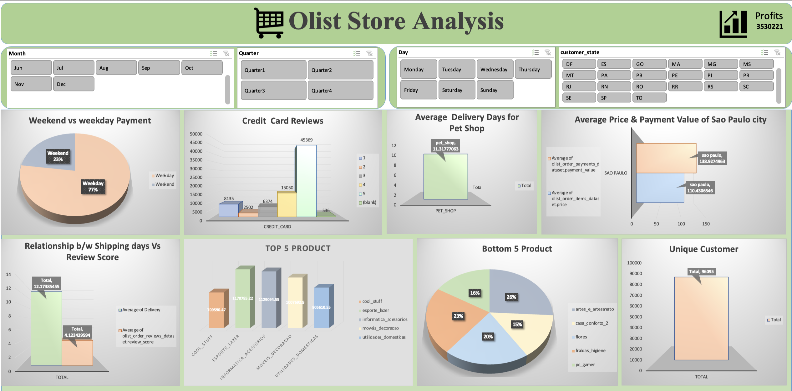
Excel Dashboard

Slide 16
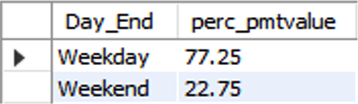
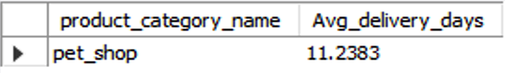
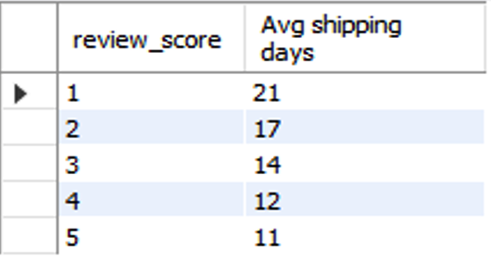
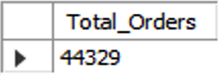
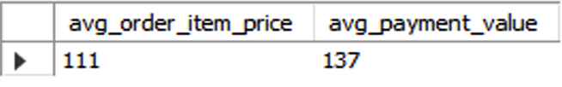
SQL Result Sets
KPI 1
KPI 3
KPI 5
KPI 2
KPI 4

Slide 17
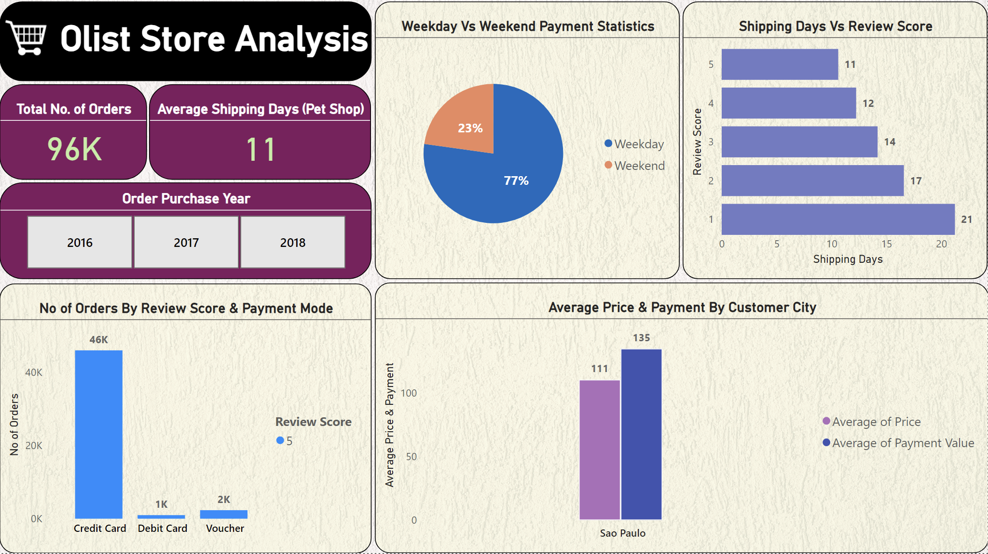
Power BI Dashboard

Slide 18
CONCLUSION
Overall, dashboard provides a comprehensive view of the business allowing for targeted strategies to improve customer satisfaction, operational efficiency and profitability.
To enhance overall business performance, the e-commerce store should focus on optimizing promotional strategies, enhancing payment convenience, improving delivery efficiency.
By addressing these areas, the store can improve customer satisfaction, boost sales and maintain a competitive edge in the market. Proactive measures and continuous optimization based on customer feedback and behaviour will be key to sustaining growth and success.

Slide 19
THANK YOU

